Slide 1
Digital Logic and Computer Design
M. Morris Mano
Ninteenth Edition or Latest Edition
Chapter 1 <number>

Slide 2
Overview
Digital Systems and Computer Systems
Information Representation
Number Systems [binary, octal and hexadecimal]
Arithmetic Operations
Base Conversion
Decimal Codes [BCD (binary coded decimal), parity]
Gray Codes
Alphanumeric Codes
Chapter 1 <number>

Slide 3
Digital System
Takes a set of discrete information inputs and discrete internal information (system state) and generates a set of discrete information outputs.
Discrete
Discrete
Inputs
Information
Discrete
Processing
Outputs
System
System State
Chapter 1 <number>

Slide 4
Types of Digital Systems
No state present
  Combinational Logic System
  Output = Function(Input)
State present
  State updated at discrete times
  => Synchronous Sequential System
  State updated at any time
  =>Asynchronous Sequential System
  State = Function (State, Input)
  Output = Function (State)
  or Function (State, Input)
Chapter 1 <number>

Slide 5
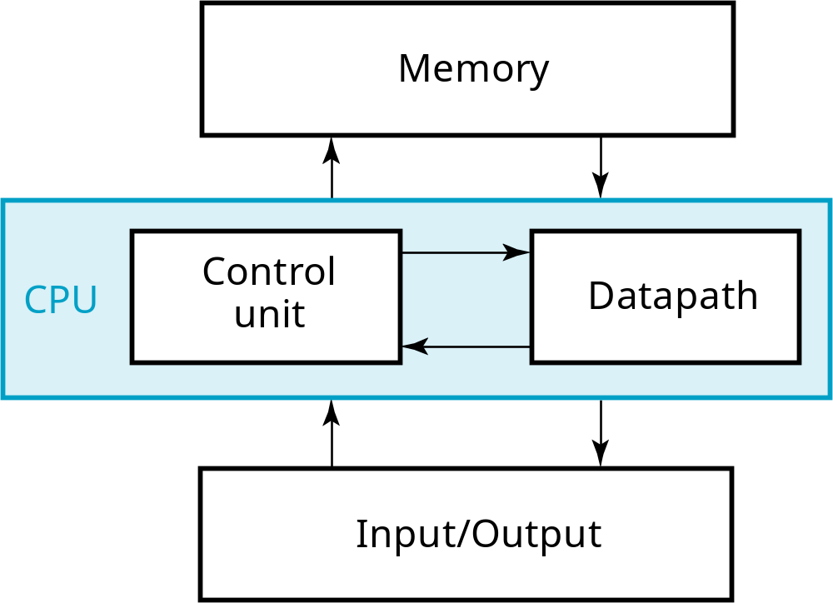
A Digital Computer Example
Inputs: Keyboard, mouse, modem, microphone
Outputs: CRT, LCD, modem, speakers
Synchronous or Asynchronous?
Chapter 1 <number>
Notes:
Answer: Part of specification for a PC is in MHz. What does that imply? A clock which defines the discrete times for update of state for a synchronous system. Not all of the computer may be synchronous, however.

Slide 6
Signal
An information variable represented by physical quantity.
For digital systems, the variable takes on discrete values.
Two level, or binary values are the most prevalent values in digital systems.
Binary values are represented abstractly by:
  digits 0 and 1
  words (symbols) False (F) and True (T)
  words (symbols) Low (L) and High (H)
  and words On and Off.
Binary values are represented by values or ranges of values of physical quantities
Chapter 1 <number>

Slide 7
Signal Examples Over Time
Time
Continuous in value & time
Analog
Digital
Discrete in value & continuous in time
Asynchronous
Synchronous
Discrete in value & time
Chapter 1 <number>

Slide 8
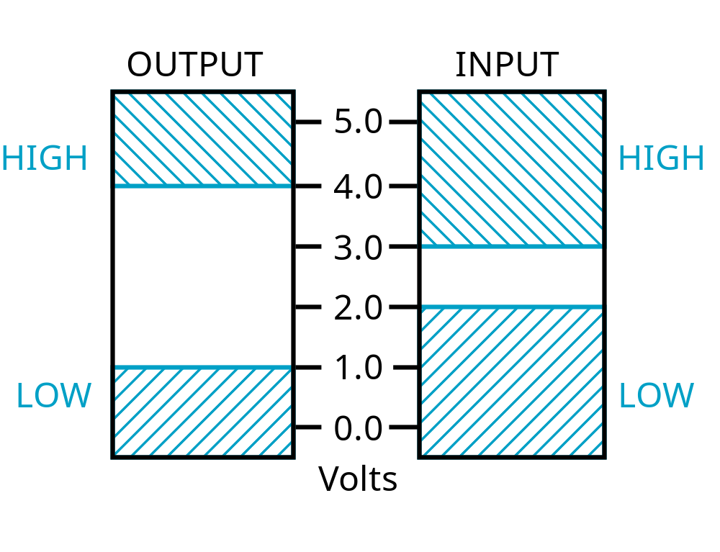
Signal Example – Physical Quantity: Voltage
Threshold Region
Chapter 1 <number>
Notes:
The HIGH range typically corresponds to binary 1 and LOW range to binary 0. The threshold region is a range of voltages
for which the input voltage value cannot be interpreted reliably as either a 0 or a 1.

Slide 9
Binary Values: Other Physical Quantities
What are other physical quantities represent 0 and 1?
  CPU Voltage
  Disk
  CD
  Dynamic RAM
Magnetic Field Direction
Surface Pits/Light
Electrical Charge
Chapter 1 <number>

Slide 10
Number Systems – Representation
Positive radix, positional number systems
A number with radix r is represented by a string of digits:
A_{n - 1}A_{n - 2} … A₁A₀ . A₋ ₁ A₋ ₂ … A_{- m + 1} A_{- m}
in which 0 ≤ A_{i} < r and . is the radix point.
The string of digits represents the power series:
(
)
(
)
i = n - 1
j = - 1
(Number)_{r}
=
∑
i
+
∑
j
A
r
A
r
i
j
i = 0
j = - m
(Integer Portion)
(Fraction Portion)
+
Chapter 1 <number>

Slide 11
Number Systems – Examples
 | General | Decimal | Binary
Radix (Base) | r | 10 | 2
Digits | 0 => r - 1 | 0 => 9 | 0 => 1
0 1 2 3 Powers of 4 Radix 5 -1 -2 -3 -4 -5 | r⁰ r¹ r² r³ r⁴ r⁵ r ⁻¹ r ⁻² r ⁻³ r ⁻⁴ r ⁻⁵ | 1 10 100 1000 10,000 100,000 0.1 0.01 0.001 0.0001 0.00001 | 1 2 4 8 16 32 0.5 0.25 0.125 0.0625 0.03125
Chapter 1 <number>

Slide 12
Special Powers of 2
2¹⁰ (1024) is Kilo, denoted "K"
2²⁰ (1,048,576) is Mega, denoted "M"
2³⁰ (1,073, 741,824)is Giga, denoted "G"
Chapter 1 <number>

Slide 13
Positive Powers of 2
Useful for Base Conversion
Exponent
Value
Exponent
Value
0
1
11
2,048
1
2
12
4,096
2
4
13
8,192
3
8
14
16,384
4
16
15
32,768
5
32
16
65,536
6
64
17
131,072
7
128
18
262,144
8
256
19
524,288
9
512
20
1,048,576
10
1024
21
2,097,152
Chapter 1 <number>

Slide 14
Converting Binary to Decimal
To convert to decimal, use decimal arithmetic to form Σ (digit × respective power of 2).
Example:Convert 11010₂ to N₁₀:
Chapter 1 <number>
Notes:
Powers of 2: 43210
11010₂ =>
1 X 2⁴ = 16
+ 1 X 2³ = 8
+ 0 X 2² = 0
+ 1 X 2¹ = 2
+ 0 X 2⁰ = 0
26₁₀

Slide 15
Converting Decimal to Binary
Method 1
  Subtract the largest power of 2 (see slide 14) that gives a positive remainder and record the power.
  Repeat, subtracting from the prior remainder and recording the power, until the remainder is zero.
  Place 1’s in the positions in the binary result corresponding to the powers recorded; in all other positions place 0’s.
Example: Convert 625₁₀ to N₂
Chapter 1 <number>
Notes:
625 – 512 = 113 => 9
113 – 64 = 49 => 6
49 – 32 = 17 => 5
17 – 16 = 1 => 4
1 – 1 = 0 => 0
Placing 1’s in the result for the positions recorded and 0’s elsewhere,
9 8 7 6 5 4 3 2 1 0
1 0 0 1 1 1 0 0 0 1

Slide 16
Commonly Occurring Bases
Name
Radix
Digits
Binary
2
0,1
Octal
8
0,1,2,3,4,5,6,7
Decimal
10
0,1,2,3,4,5,6,7,8,9
Hexadecimal
16
0,1,2,3,4,5,6,7,8,9,A,B,C,D,E,F
The six letters (in addition to the 10
integers) in hexadecimal represent:
Chapter 1 <number>
Notes:
Answer: The six letters A, B, C, D, E, and F represent the digits for values
10, 11, 12, 13, 14, 15 (given in decimal), respectively, in hexadecimal.
Alternatively, a, b, c, d, e, f are used.

Slide 17
Numbers in Different Bases
Good idea to memorize!
Decimal
Binary
Octal
Hexa
decimal
(Base 10)
(Base 2)
(Base 8)
(Base 16)
00
00000
00
00
01
00001
01
01
02
00010
02
02
03
00011
03
03
04
00100
04
04
05
00101
05
05
06
00110
06
06
07
00111
07
07
08
01000
10
08
09
01001
11
09
10
01010
12
0A
11
0101
1
13
0B
12
01100
14
0C
13
01101
15
0D
14
01110
16
0E
15
01111
17
0F
16
10000
20
10
Chapter 1 <number>

Slide 18
Conversion Between Bases
Method 2
To convert from one base to another:
1) Convert the Integer Part
2) Convert the Fraction Part
3) Join the two results with a radix point
Chapter 1 <number>

Slide 19
Conversion Details
To Convert the Integral Part:
  Repeatedly divide the number by the new radix and save the remainders. The digits for the new radix are the remainders in reverse order of their computation. If the new radix is > 10, then convert all remainders > 10 to digits A, B, …
To Convert the Fractional Part:
  Repeatedly multiply the fraction by the new radix and save the integer digits that result. The digits for the new radix are the integer digits in order of their computation. If the new radix is > 10, then convert all integers > 10 to digits A, B, …
Chapter 1 <number>

Slide 20
Example: Convert 46.6875₁₀ To Base 2
Convert 46 to Base 2
Convert 0.6875 to Base 2:
Join the results together with the radix point:
Chapter 1 <number>
Notes:
Answer 1: Converting 46 as integral part: Answer 2: Converting 0.6875 as fractional part:
46/2 = 23 rem = 0 0.6875 * 2 = 1.3750 int = 1
23/2 = 11 rem = 1 0.3750 * 2 = 0.7500 int = 0
11/2 = 5 remainder = 1 0.7500 * 2 = 1.5000 int = 1
5/2 = 2 remainder = 1 0.5000 * 2 = 1.0000 int = 1
2/2 = 1 remainder = 0 0.0000
1/2 = 0 remainder = 1 Reading off in the forward direction: 0.1011₂
Reading off in the reverse direction: 101110₂
Answer 3: Combining Integral and Fractional Parts:
101110. 1011₂

Slide 21
Additional Issue - Fractional Part
Note that in this conversion, the fractional part became 0 as a result of the repeated multiplications.
In general, it may take many bits to get this to happen or it may never happen.
Example: Convert 0.65₁₀ to N₂
  0.65 = 0.1010011001001 …
  The fractional part begins repeating every 4 steps yielding repeating 1001 forever!
Solution: Specify number of bits to right of radix point and round or truncate to this number.
Chapter 1 <number>

Slide 22
Checking the Conversion
To convert back, sum the digits times their respective powers of r.
From the prior conversion of 46.6875₁₀
101110₂ = 1·32 + 0·16 +1·8 +1·4 + 1·2 +0·1
= 32 + 8 + 4 + 2
= 46
0.1011₂ = 1/2 + 1/8 + 1/16
= 0.5000 + 0.1250 + 0.0625
= 0.6875
Chapter 1 <number>

Slide 23
Why Do Repeated Division and Multiplication Work?
Divide the integer portion of the power series on slide 11 by radix r. The remainder of this division is A₀, represented by the term A₀/r.
Discard the remainder and repeat, obtaining remainders A₁, …
Multiply the fractional portion of the power series on slide 11 by radix r. The integer part of the product is A₋₁.
Discard the integer part and repeat, obtaining integer parts A₋₂, …
This demonstrates the algorithm for any radix r >1.
Chapter 1 <number>
Notes:
Divide integral part equation on slide 21 by r. Note that the powers of r decline by 1 in the quotient and that a fraction a₀/r results, giving a₀ as the remainder.
The next time, fraction a₁/r results giving a₁ as the remainder.
In general, the remainder will be a_{i} for the ith step.
At the nth step, a_{n}/r will result with the quotient = 0.
Similarly, for multiply, a_{–1} will emerge as the integral part first since r x r ^{–1} = 1.

Slide 24
Octal (Hexadecimal) to Binary and Back
Octal (Hexadecimal) to Binary:
  Restate the octal (hexadecimal) as three (four) binary digits starting at the radix point and going both ways.
Binary to Octal (Hexadecimal):
  Group the binary digits into three (four) bit groups starting at the radix point and going both ways, padding with zeros as needed in the fractional part.
  Convert each group of three bits to an octal (hexadecimal) digit.
Chapter 1 <number>

Slide 25
Octal to Hexadecimal via Binary
Convert octal to binary.
Use groups of four bits and convert as above to hexadecimal digits.
Example: Octal to Binary to Hexadecimal
6 3 5 . 1 7 7 ₈
Why do these conversions work?
Chapter 1 <number>
Notes:
Answer 1:
6 3 5 . 1 7 7 ₈
110|011|101 . 001|111|111 ₂
Regroup:
1|1001|1101 . 0011|1111|1(000)₂
Convert:
1 9 D . 3 F 8₁₆
Answer 2: Marking off in groups of three (four) bits corresponds to dividing or multiplying by 2³ = 8 (2⁴ = 16) in the binary system.

Slide 26
A Final Conversion Note
You can use arithmetic in other bases if you are careful:
Example: Convert 101110₂ to Base 10 using binary arithmetic:
  Step 1 101110 / 1010 = 100 r 0110
  Step 2 100 / 1010 = 0 r 0100
  Converted Digits are 0100₂ | 0110₂
  or 4 6 ₁₀
Chapter 1 <number>

Slide 27
Binary Numbers and Binary Coding
Flexibility of representation
  Within constraints below, can assign any binary combination (called a code word) to any data as long as data is uniquely encoded.
Information Types
  Numeric
    Must represent range of data needed
    Very desirable to represent data such that simple, straightforward computation for common arithmetic operations permitted
    Tight relation to binary numbers
  Non-numeric
    Greater flexibility since arithmetic operations not applied.
    Not tied to binary numbers
Chapter 1 <number>

Slide 28
Non-numeric Binary Codes
Given n binary digits (called bits), a binary code is a mapping from a set of represented elements to a subset of the 2^{n} binary numbers.
Example: A
binary code
for the seven
colors of the
rainbow
Code 100 is
not used
Color
Binary Number
Red
000
Orange
001
Yellow
010
Green
011
Blue
101
Indigo
110
Violet
111
Chapter 1 <number>

Slide 29
Number of Bits Required
Given M elements to be represented by a binary code, the minimum number of bits, n, needed, satisfies the following relationships:
    2^{n} > M > 2^{(n – 1)}
    n = log₂ M where x , called the ceiling
    function, is the integer greater than or equal to x.
Example: How many bits are required to represent decimal digits with a binary code?
Chapter 1 <number>
Notes:
M = 10
Therefore n = 4 since:
2⁴ =16 is ≥ 10 > 2³ = 8
and the ceiling function for log₂ 10 is 4.

Slide 30
Number of Elements Represented
Given n digits in radix r, there are r^{n} distinct elements that can be represented.
But, you can represent m elements, m < r^{n}
Examples:
  You can represent 4 elements in radix r = 2 with n = 2 digits: (00, 01, 10, 11).
  You can represent 4 elements in radix r = 2 with n = 4 digits: (0001, 0010, 0100, 1000).
  This second code is called a "one hot" code.
Chapter 1 <number>

Slide 31
Binary Codes for Decimal Digits
There are over 8,000 ways that you can chose 10 elements from the 16 binary numbers of 4 bits. A few are useful:
Decimal
8,4,2,1
Excess3
8,4,
-
2,
-
1
0
0000
0011
0000
1
0001
0100
0111
2
0010
0101
0110
3
0011
0110
0101
4
0100
0111
0100
5
0101
1000
1011
6
0110
1001
1010
7
0111
1010
1001
8
1000
1011
1000
9
1001
1
100
1111
Chapter 1 <number>

Slide 32
Binary Coded Decimal (BCD)
The BCD code is the 8,4,2,1 code.
This code is the simplest, most intuitive binary code for decimal digits and uses the same powers of 2 as a binary number, but only encodes the first ten values from 0 to 9.
Example: 1001 (9) = 1000 (8) + 0001 (1)
How many “invalid” code words are there?
What are the “invalid” code words?
Chapter 1 <number>
Notes:
Answer 1: 6
Answer 2: 1010, 1011, 1100, 1101, 1110, 1111

Slide 33
Excess 3 Code and 8, 4, –2, –1 Code
Decimal | Excess 3 | 8, 4, –2, –1
0 | 0011 | 0000
1 | 0100 | 0111
2 | 0101 | 0110
3 | 0110 | 0101
4 | 0111 | 0100
5 | 1000 | 1011
6 | 1001 | 1010
7 | 1010 | 1001
8 | 1011 | 1000
9 | 1100 | 1111
What interesting property is common to these two codes?
Chapter 1 <number>
Notes:
Answer: Both of these codes have the property that the codes for 0 and 9, 1 and 8, etc. can be obtained from each other by replacing the 0’s with the 1’s and vice-versa in the code words. Such a code is sometimes called a complement code.

Slide 34
GRAY CODE....
The output data of many physical systems are quantities that are continuous. These data must be converted into digital form before they are applied to a digital system. Continuous or analog information is converted into digital form by means of an analog-to-digital converter. It is some times convenient to use the Gray code.
Chapter 1 <number>

Slide 35
Gray Code
The advantage of the Gray code over the straight binary number sequence is that only one bit in the code group changes in going from one number to the next.
Decimal
8,4,2,1
Gray
0
0000
0000
1
0001
0100
2
0010
0101
3
0011
0111
4
0100
0110
5
0101
0010
6
0110
0011
7
0111
0001
8
1000
1001
9
1001
1000
Chapter 1 <number>

Slide 36
Gray Code (Continued)
Does this special Gray code property have any value?
An Example: Optical Shaft Encoder
111
000
100
000
B
0
B
1
110
001
101
001
B
2
G
2
G
1
010
111
G
0
101
011
100
011
110
010
(a) Binary Code for Positions 0 through 7
(b) Gray Code for Positions 0 through 7
Chapter 1 <number>
Notes:
Yes, as illustrated by the example that followed.

Slide 37
Warning: Conversion or Coding?
Do NOT mix up conversion of a decimal number to a binary number with coding a decimal number with a BINARY CODE.
13₁₀ = 1101₂ (This is conversion)
13 ⇔ 0001|0011 (This is coding)
Chapter 1 <number>

Slide 38
Binary Arithmetic
Single Bit Addition with Carry
Multiple Bit Addition
Single Bit Subtraction with Borrow
Multiple Bit Subtraction
Multiplication
BCD Addition
Chapter 1 <number>

Slide 39
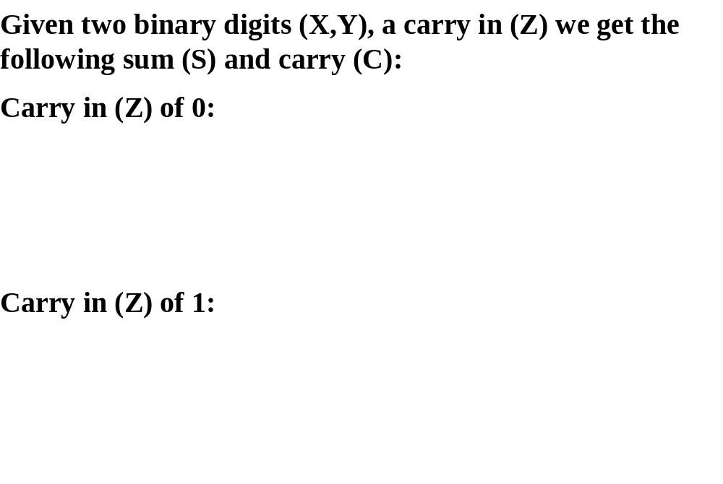
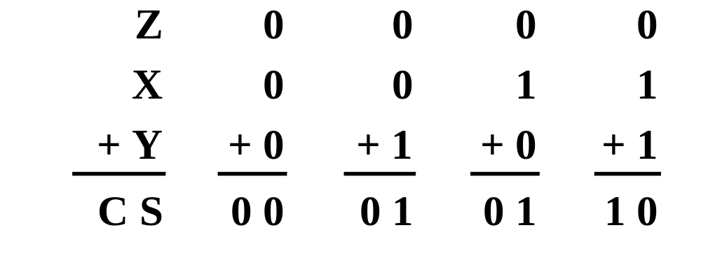
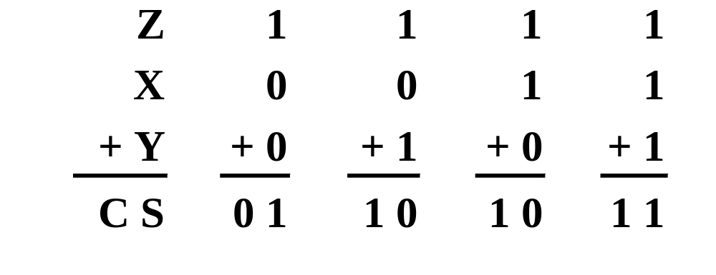
Single Bit Binary Addition with Carry
Chapter 1 <number>

Slide 40
Multiple Bit Binary Addition
Extending this to two multiple bit examples:
Carries 0 0
Augend 01100 10110
Addend +10001 +10111
Sum
Note: The 0 is the default Carry-In to the least significant bit.
Chapter 1 <number>
Notes:
Carries 00000 01100
Augend 01100 10110
Addend +10001 +10111
Sum 11101 101101

Slide 41
Single Bit Binary Subtraction with Borrow
Given two binary digits (X,Y), a borrow in (Z) we get the following difference (S) and borrow (B):
Borrow in (Z) of 0:
Borrow in (Z) of 1:
Z
0
0
0
0
X
0
0
1
1
- Y
-0
-1
-0
-1
BS
0 0
1 1
0 1
0 0
Z
1
1
1
1
X
0
0
1
1
- Y
-0
-1
-0
-1
BS
11
1 0
0 0
1 1
Chapter 1 <number>

Slide 42
Multiple Bit Binary Subtraction
Extending this to two multiple bit examples:
Borrows 0 0
Minuend 10110 10110
Subtrahend - 10010 - 10011
Difference
Notes: The 0 is a Borrow-In to the least significant bit. If the Subtrahend > the Minuend, interchange and append a – to the result.
Chapter 1 <number>
Notes:
Borrows 00000 00110
Minuend 10110 10110
Subtrahend –10010 –10011
Difference 00100 00011

Slide 43
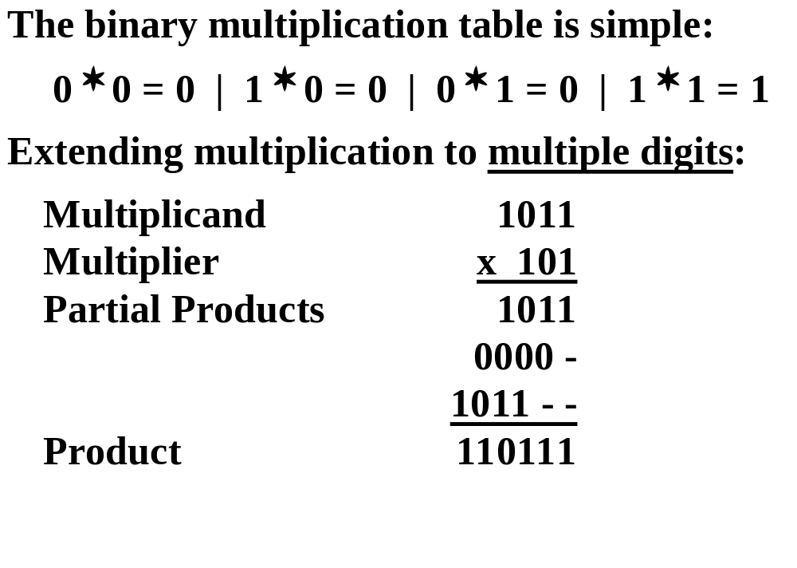
Binary Multiplication
Chapter 1 <number>

Slide 44
BCD Arithmetic
Given a BCD code, we use binary arithmetic to add the digits:
8
1000
Eight
+5
+0101
Plus 5
13
1101
is 13 (> 9)
Note that the result is MORE THAN 9, so must be
represented by two digits!
To correct the digit, subtract 10 by adding 6 modulo 16.
8
1000
Eight
+5
+0101
Plus 5
13
1101
is 13 (> 9)
+0110
so add 6
carry = 1
0011
leaving 3 + cy
0001 | 0011
Final answer (two digits)
If the digit sum is > 9, add one to the next significant digit
Chapter 1 <number>

Slide 45
BCD Addition Example
Add 2905_{BCD} to 1897_{BCD} showing carries and digit corrections.
0
0001 1000 1001 0111
+ 0010 1001 0000 0101
Chapter 1 <number>
Notes:
1 1 1 0
0001 1000 1001 0111
+ 0010 1001 0000 0101
0100 10010 1010 1100
+ 0000+ 0110+ 0110+ 0110
0100 1000 0000 0010

Slide 46
Error-Detection Codes
Redundancy (e.g. extra information), in the form of extra bits, can be incorporated into binary code words to detect and correct errors.
A simple form of redundancy is parity, an extra bit appended onto the code word to make the number of 1’s odd or even. Parity can detect all single-bit errors and some multiple-bit errors.
A code word has even parity if the number of 1’s in the code word is even.
A code word has odd parity if the number of 1’s in the code word is odd.
Chapter 1 <number>

Slide 47
4-Bit Parity Code Example
Fill in the even and odd parity bits:
The codeword "1111" has even parity and the codeword "1110" has odd parity. Both can be used to represent 3-bit data.
Even Parity
Odd Parity
Message
-
Parity
Message
-
Parity
000
-
000
-
001
-
001
-
010
-
010
-
011
-
011
-
100
-
100
-
101
-
101
-
110
-
110
-
111
-
111
-
Chapter 1 <number>
Notes:
Even Parity Bits: 0, 1, 1, 0, 1, 0, 0, 1
Odd Parity Bits: 1, 0, 0, 1, 0, 1, 1, 0

Slide 48
ASCII Character Codes
American Standard Code for Information Interchange
This code is a popular code used to represent information sent as character-based data. It uses 7-bits to represent:
  94 Graphic printing characters.
  34 Non-printing characters
Some non-printing characters are used for text format (e.g. BS = Backspace, CR = carriage return)
Other non-printing characters are used for record marking and flow control (e.g. STX and ETX start and end text areas).
(Refer to Table 1
-4 in the text)
Chapter 1 <number>

Slide 49
ASCII Properties
ASCII has some interesting properties:
Digits 0 to 9 span Hexadecimal values 30₁₆
to 39₁₆
.
Upper case A
-
Z span 41₁₆
to 5A₁₆
.
Lower case a
-
z span 61₁₆
to 7A₁₆
.
Lower to upper case translation (and vice versa)
occurs by
flipping bit 6.
Delete (DEL) is all bits set,
a carryover from when
punched paper tape was used to store messages.
Punching all holes in a row erased a mistake!
Chapter 1 <number>

Slide 50
UNICODE
UNICODE extends ASCII to 65,536 universal characters codes
Chapter 1 <number>

Slide 51
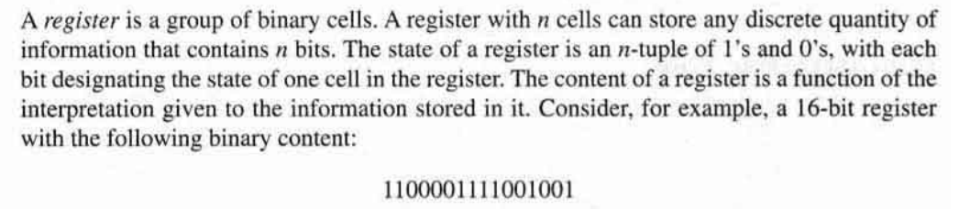
Registers
A register with 16 cells can be in one of 2¹⁶ possible states.
Chapter 1 <number>

Slide 52
Register Transfer.....
A digital system is characterized by its registers and the components that perform data processing. In digital systems, a register transfer operation is a basic operation that consists of a transfer of binary information from one set of registers into another set of registers.
.
Chapter 1 <number>

Slide 53
Register Transfer.....Continue....
The transfer may be direct from one register to another or may pass through data -processing circuits to perform an operation.
Chapter 1 <number>

Slide 54
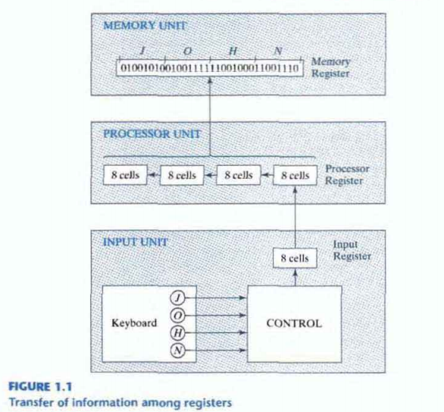
Register Transfer.....Continue....
Chapter 1 <number>

Slide 55
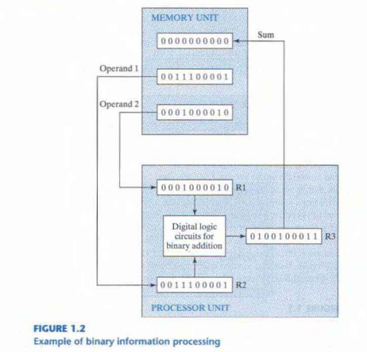
Register Transfer.....Continue....
Chapter 1 <number>

